Slide 1
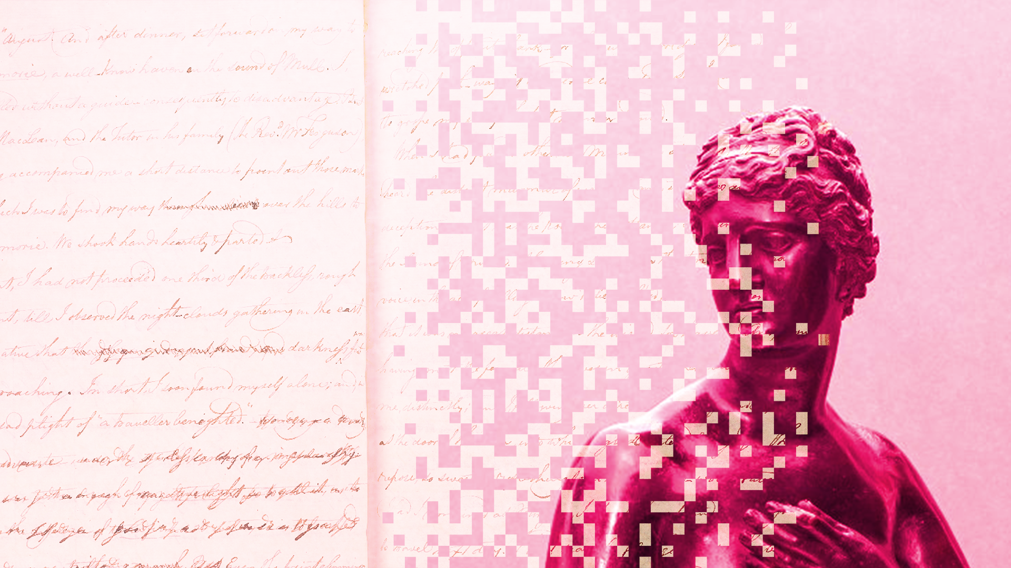



Data
Culture
society
@edCDCS
Notes:
MT

Slide 2


Introduction to Text Analysis With Python
16 & 25 Feb 2026
Instructor: Joy Lan
Adapted from materials made by Xandra Dave Cochran
Notes:
MT

Slide 3
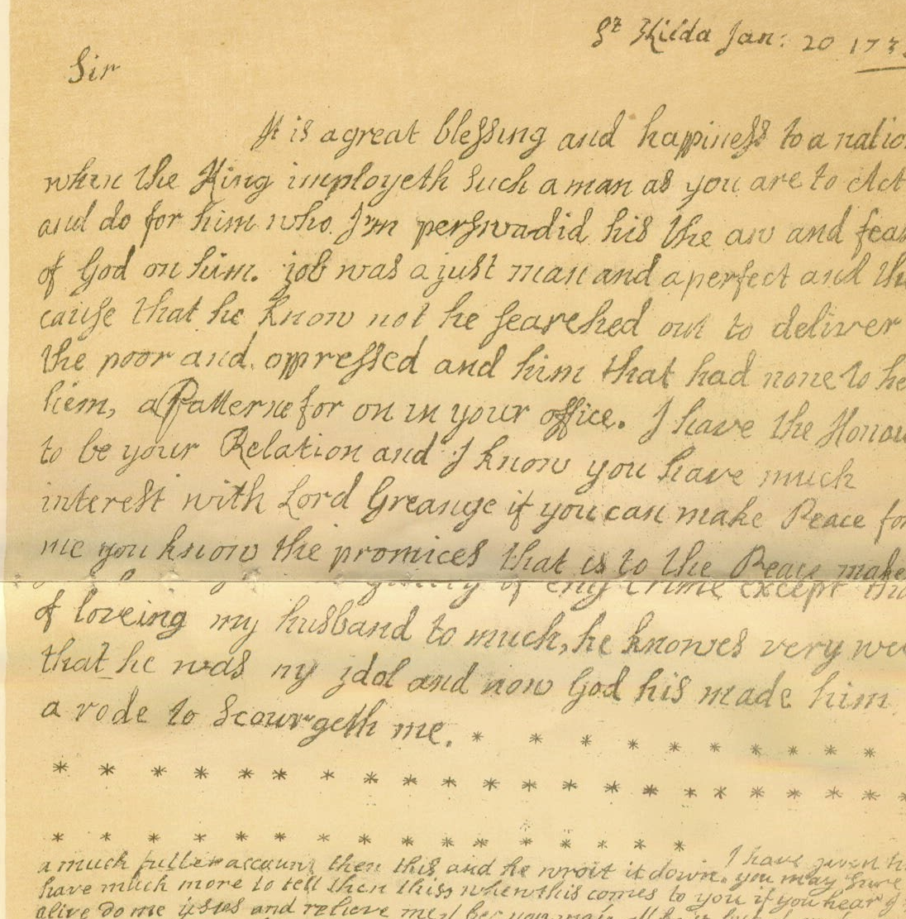

Course Topic
Analysing unstructured data with Python
Natural Language Toolkit (NLTK)
Regular Expressions
www.cdcs.ed.ac.uk

Slide 4
Course Structure
Anticipate about ~7 hours/week
2 hour course, 2-4 pm on Monday
1 assignment per week, ~2 hours
Independent learning, ~2 hours
Office hours on request on Teams
All materials will be uploaded to the course page on Github
www.cdcs.ed.ac.uk

Slide 5
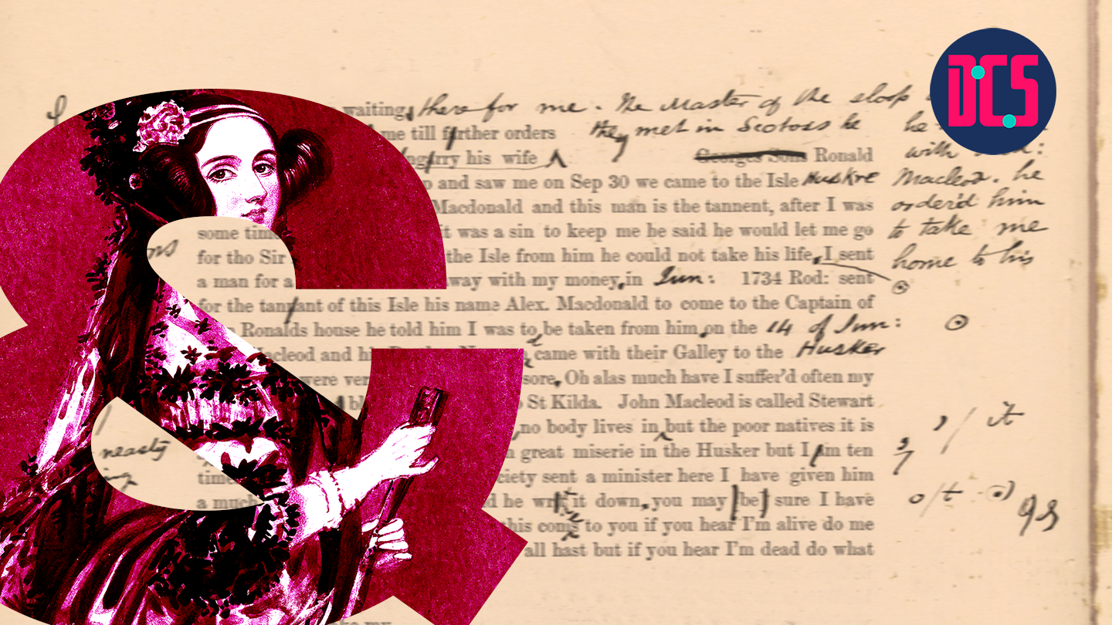
Introduction
Why are you interested in text analysis?
Have you used Python before?
Have you used Jupyter Notebooks or Google Colab before?
Have you used Regular Expressions before?
Have you used NLTK before?
www.cdcs.ed.ac.uk

Slide 6

Course Software
Jupyter Notebooks / Jupyterlabs
With Notable https://www.ed.ac.uk/information-services/learning-technology/noteable/accessing-noteable
After logging into MyEd: https://noteable.edina.ac.uk/launch
With Google Colab https://colab.research.google.com
Locally (install with pip/pip3 or conda)
www.cdcs.ed.ac.uk
Notes:
Building capacity in the Digital Humanities
The Digital Research Infrastructure for the Arts and Humanities (DARIAH) aims to enhance and support digitally-enabled research and teaching across the arts and humanities. DARIAH is a network of people, expertise, information, knowledge, content, methods, tools and technologies from its member countries. It develops, maintains and operates an infrastructure in support of ICT-based research practices and sustains researchers in using them to build, analyse and interpret digital resources. By working with communities of practice, DARIAH brings together individual state-of-the-art digital arts and humanities activities and scales their results to a European level. It preserves, provides access to and disseminates research that stems from these collaborations and ensures that best practices, methodological and technical standards are followed.

Slide 7
DEMO 1

Slide 8
Demo 1
Identify issues you might encounter when processing the following images.
Are there any steps you could take to preprocessing the document that might improve the output accuracy?
www.cdcs.ed.ac.uk

Slide 9
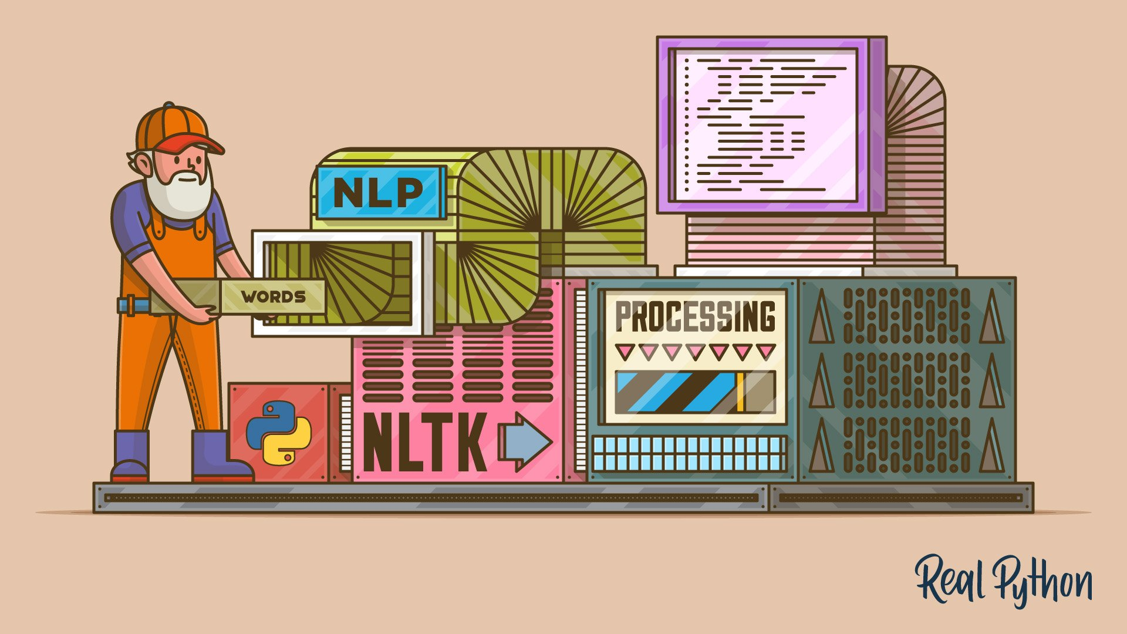
NLTK
Natural Language Toolkit
Natural language = human language
= “unstructured”data
www.cdcs.ed.ac.uk

Slide 10
NLTK
Examples of data sources for natural language:
• Books
• Newspapers
• Magazines
• Websites
• Transcriptions of audio (i.e. interview, movie dialogue)
• Social media
Always read the licensing/copyright information and terms of use!
www.cdcs.ed.ac.uk

Slide 11
Why use NLTK
What kinds of questions can you ask when you can use a programming language to study hundreds, thousands, or even millions of pages of digital text?
“Distant reading”
www.cdcs.ed.ac.uk

Slide 12
Why use NLTK
What kinds of questions can you ask when you can use a programming language to study hundreds, thousands, or even millions of pages of digital text?
“Distant reading”
NLTK Isn’t everything
What kinds of questions can you ask when you can physically hold and look at a printed text, be it an original publication or later edition of the text?
“Close reading”
Book history
www.cdcs.ed.ac.uk
Notes:
Building capacity in the Digital Humanities
The Digital Research Infrastructure for the Arts and Humanities (DARIAH) aims to enhance and support digitally-enabled research and teaching across the arts and humanities. DARIAH is a network of people, expertise, information, knowledge, content, methods, tools and technologies from its member countries. It develops, maintains and operates an infrastructure in support of ICT-based research practices and sustains researchers in using them to build, analyse and interpret digital resources. By working with communities of practice, DARIAH brings together individual state-of-the-art digital arts and humanities activities and scales their results to a European level. It preserves, provides access to and disseminates research that stems from these collaborations and ensures that best practices, methodological and technical standards are followed.

Slide 13
NLTK Terminology
Tokens vs. words
Digitized vs. digital
Normalization (a.k.a. standardization)
Document vs. corpus vs. corpora
www.cdcs.ed.ac.uk

Slide 14
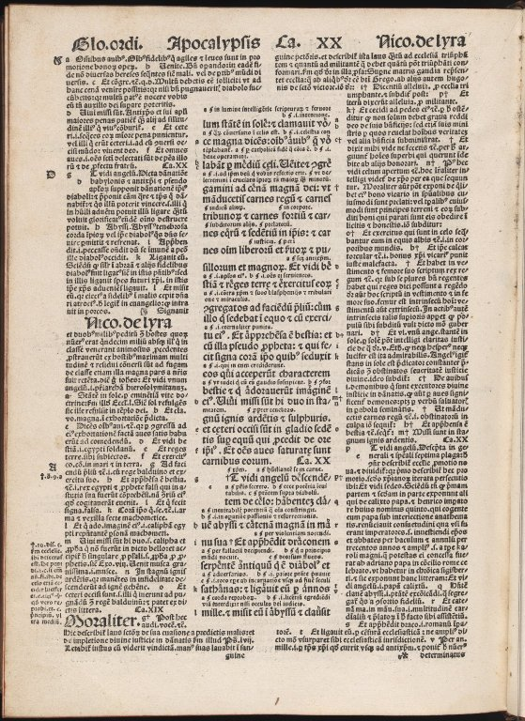
Summarising a Text
Built-in functions include:
len(text)
sorted(vocabulary_of_text)
NLTK Text methods include:
Text.count(word)
Reference: https://www.nltk.org/book/ch01.html
Biblia Sacra by N/A - University of Edinburgh, United Kingdom - CC BY.
https://www.europeana.eu/item/9200261/BibliographicResource_3000058482943
www.cdcs.ed.ac.uk

Slide 15
DEMO 2

Slide 16
Getting to know a text
NLTK Text methods include:
Text.concordance("word", lines=20)
Text.similar("word")
Text.common_contexts(["list", "of", "words"])
Text.dispersion_plot(["list", "of", "words"])
www.cdcs.ed.ac.uk

Slide 17
DEMO 3–5

Slide 18
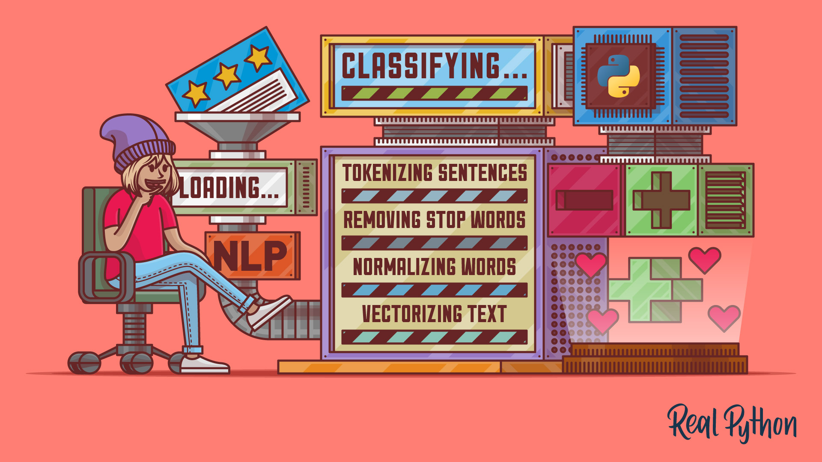
The Building Blocks
Tokenization - words/punctuation, sentences
Normalization
Stemming and lemmatizing
Frequency counts
Part-of-speech tagging
www.cdcs.ed.ac.uk

Slide 19


Tokenisation
Tokenisation involves breaking down a piece of text into smaller units called tokens.
Tokens can be individual words, sentences, or even characters, depending on the level of granularity desired.
Tokenisation helps in standardizing and organizing text data, making it easier to analyse and process.
Word-based tokenisation breaks down text into individual words, treating each word as a separate token.
www.cdcs.ed.ac.uk

Slide 20
Text cleaning & pre-processing
Formatting text for analysis and removing extraneous informationWorkflows vary depending on research objective, field, and dataset
Common steps include standardising capitalisation, removing URLs and symbols, stopword removal, tokenisation, stemming, and lemmatization
Stopwords include words like “a,” “the,” “of,” “an” that don’t add meaning to the dataset
www.cdcs.ed.ac.uk

Slide 21
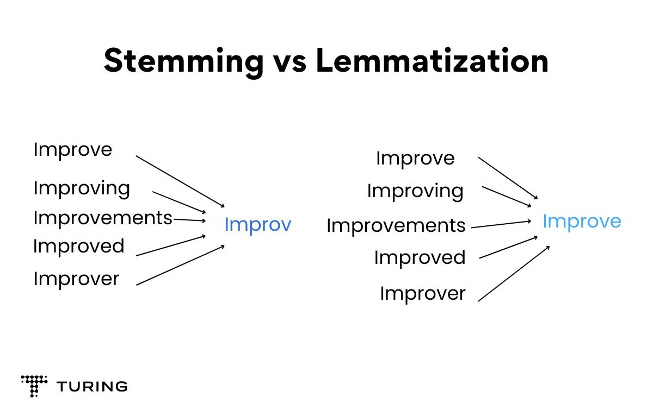
Stemming & Lemmatization
www.cdcs.ed.ac.uk

Slide 22
DEMO 6 & 7

Slide 23
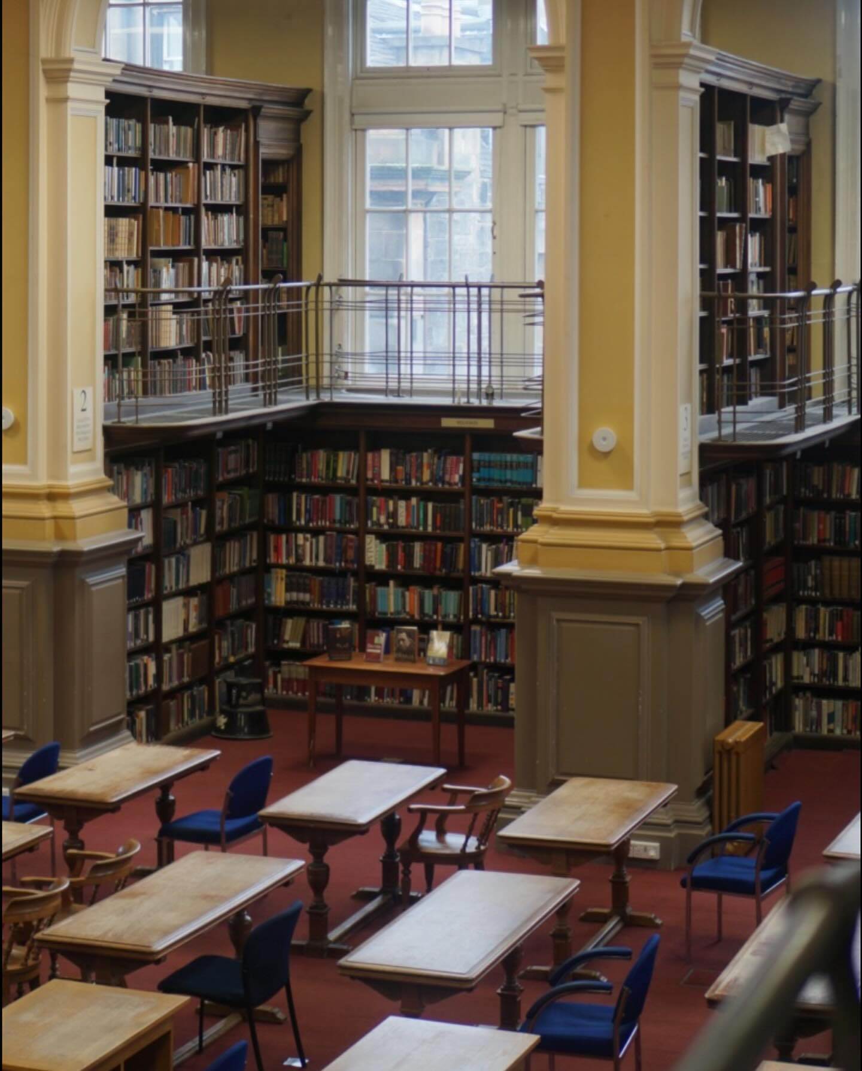
Finding Text Sources
Libraries - NLS Data Foundry (data.nls.uk)
Project Gutenberg (gutenberg.org)
Hathi Trust Digital Library (hathitrust.org)
Websites - Internet Archive (archive.org)'s Wayback Machine, UK Web
archive (webarchive.org.uk)
Newspaper archives (universities often subscribe to them!)
www.cdcs.ed.ac.uk

Slide 24
Research with NLTK
Who is named in a text?
What places are named in a text?
Chunking and Named Entity Recognition
How does the vocabulary of an author change over time?
Lexical Diversity
www.cdcs.ed.ac.uk

Slide 25
Research with NLTK
What are the common themes throughout a corpus?
Topic Modeling
What attitudes are expressed in a corpus?
Sentiment Analysis
What words occur near each other throughout a corpus? How does the meaning of a word change over time?
Word Embeddings
www.cdcs.ed.ac.uk

Slide 26
Next Week
Research with NLTK on a corpus
NLTK with pandas (for tabular data)
NLTK with Altair (for data visualization)
Regular Expression practice
Cleaning messy text
Resources for more text analysis practice
www.cdcs.ed.ac.uk

Slide 27
Further Resources from CDCS
• Digital Method of the Month on Text Analysis
• Training Pathway for Text Analysis
www.cdcs.ed.ac.uk
Notes:
Building capacity in the Digital Humanities
The Digital Research Infrastructure for the Arts and Humanities (DARIAH) aims to enhance and support digitally-enabled research and teaching across the arts and humanities. DARIAH is a network of people, expertise, information, knowledge, content, methods, tools and technologies from its member countries. It develops, maintains and operates an infrastructure in support of ICT-based research practices and sustains researchers in using them to build, analyse and interpret digital resources. By working with communities of practice, DARIAH brings together individual state-of-the-art digital arts and humanities activities and scales their results to a European level. It preserves, provides access to and disseminates research that stems from these collaborations and ensures that best practices, methodological and technical standards are followed.

Slide 28
Thanks Everyone!
Next class: Wednesday 19th, 2-4PM
Please message me on Teams for office hours!

Slide 29
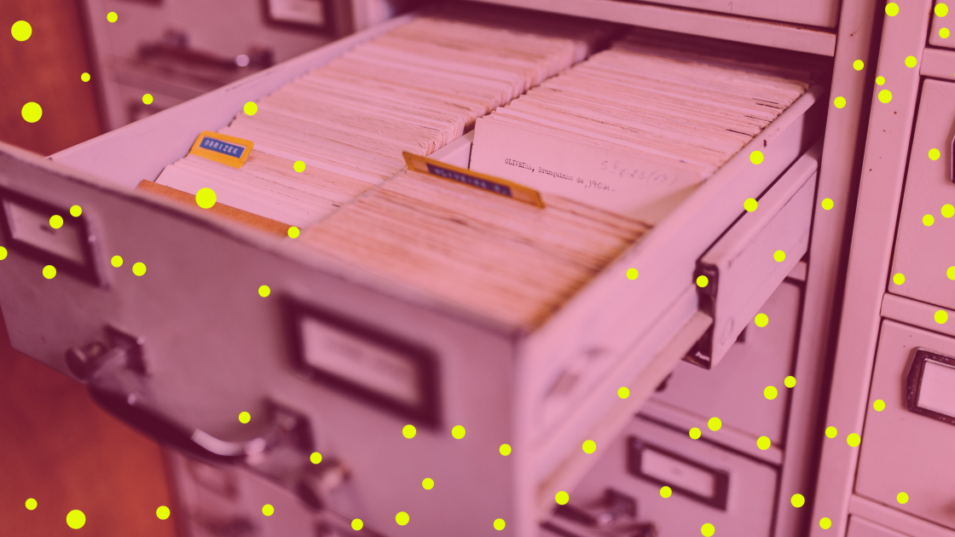

What Is OCR?
Optical Character Recognition
OCR is the technique to process images of text, such as written or printed documents, and produce machine-readable documents.
Machine-readable documents are encoded in formats that computers can process, allowing the text to be searched, edited and analysed.
www.cdcs.ed.ac.uk
Notes:
MT

Slide 30
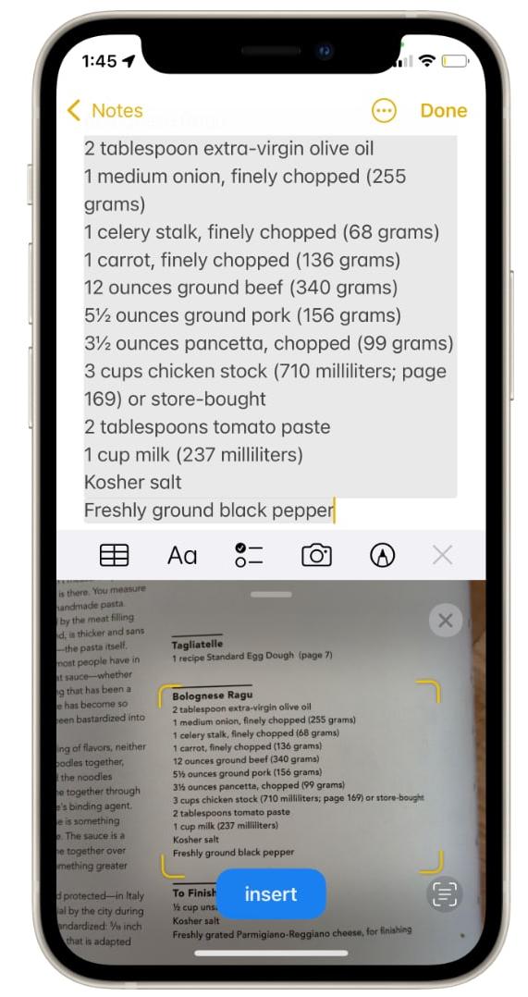
OCR In the Wild
Real-World Examples
Scanning your passport at the airport.
Generate machine-readable text for text-to-speech technology.
Making digitalised physical archives searchable.
Creating a dataset of for text mining or text analysis.
www.cdcs.ed.ac.uk
Notes:
https://www.cnbc.com/2021/09/29/ios-15-live-text-how-to-copy-and-paste-text-from-a-photo.html

Slide 31
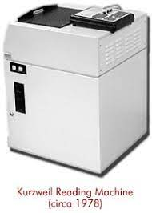
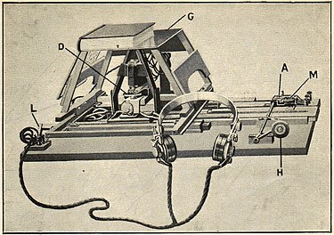
OCR Timeline: A Brief History
Early Foundations
1914: Emanuel Goldberg invents a machine that converts text into telegraph code; Edmund Fournier d’Albe invents the Optophone, which converts text to audio tones matched with letters
1931: Goldberg invents the “Statistical Machine,” which searches archives through optical code recognition
Mid-Century Machinery
1974: Ray Kurzweil develops the “Reading Machine,” an early form of OCR technology compatible with text-
to-speech software
1976: Kurzweil sells to Xerox
The Internet Era
1990s-00s: OCR goes mainstream; improved accuracy; mass digitization projects
00s-present: increased accessibility and accuracy
www.cdcs.ed.ac.uk
Notes:
MT

Slide 32
Select the images to be scanned
Scan the images with OCR software
Inspect and 'clean' the processed files
Save the results for further use
OCR workflow
www.cdcs.ed.ac.uk

Slide 33
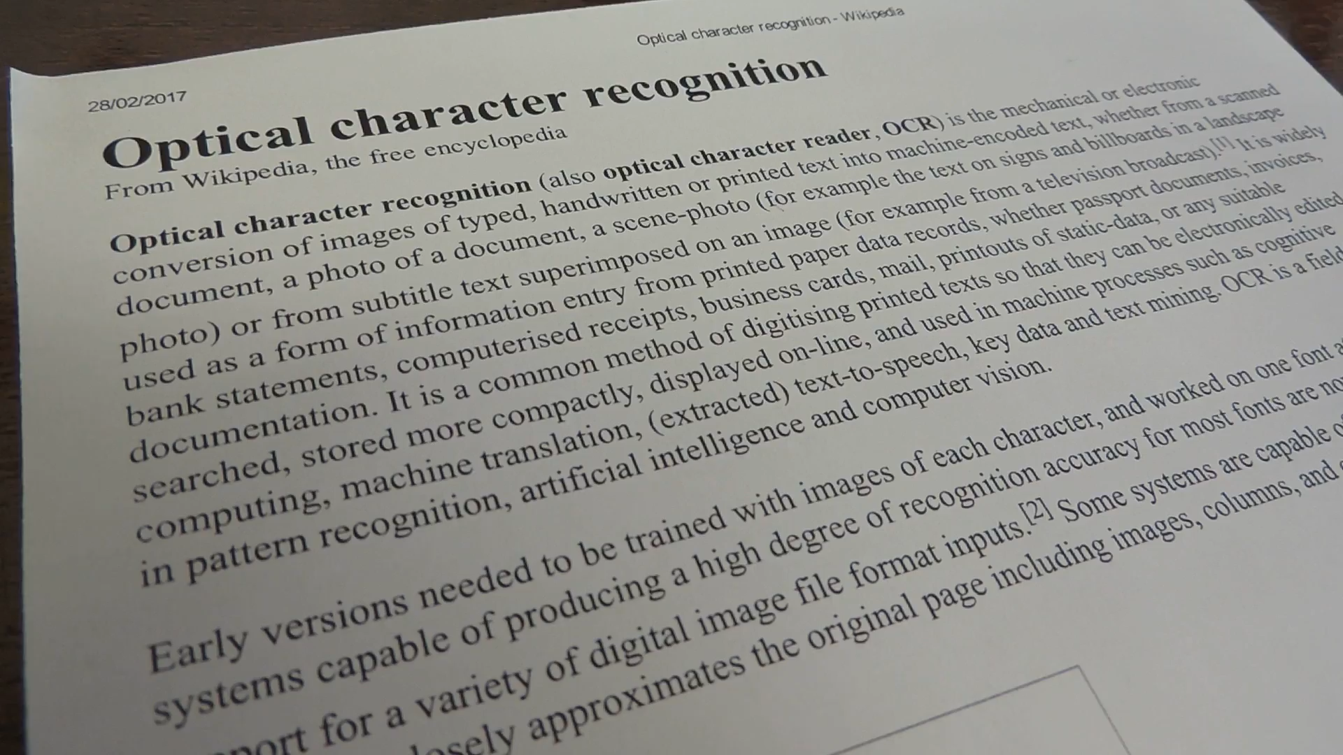
www.cdcs.ed.ac.uk

Slide 34
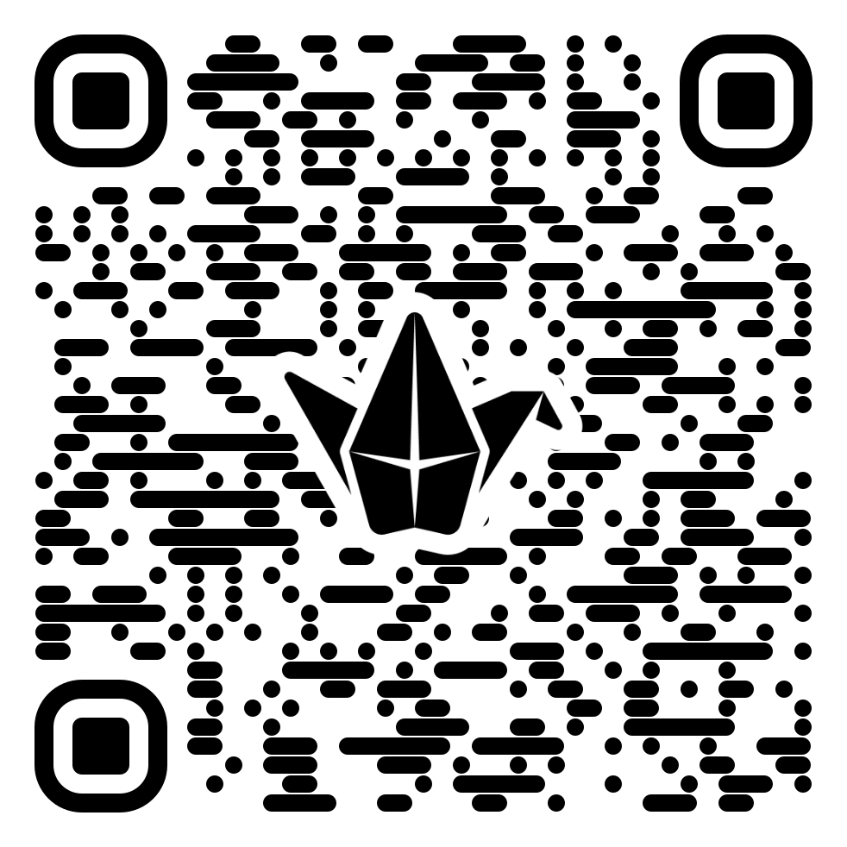
Activity:
OCR Workflow
Identify a dataset (images of text) that you might use in your research
Write the steps to obtained encoded text from your dataset. (e.g. software, OCR module)
Share your dataset, workflow, and plan with your small group.
Identify potential issue in each step. And discuss how you might address them.
www.cdcs.ed.ac.uk

Slide 35

Accuracy depends on dataset quality, visual complexity and software capability. Some common sources of error include:
Human errors and typos
Age and damage (stained or blurry)
Mixed text and images, or multiple languages
Cursive handwriting
Challenges of OCR
www.cdcs.ed.ac.uk
Notes:
MT

Slide 36
Possible solutions:
Select good quality dataset to begin with.
Pre-process your dataset to improve its quality
Correct errors in OCR-produced files, if they are predictable.
Improve OCR engine capability
Challenges of OCR
www.cdcs.ed.ac.uk
Notes:
MT

Slide 37
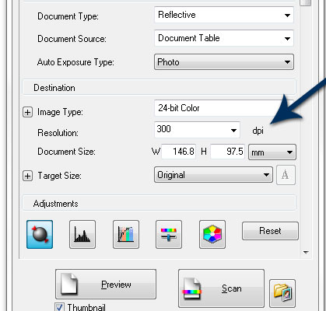
Data Selection
Image resolution
300 DPI is often used as a benchmark for good quality printing reproducibility for photographs, but this may vary
Ex. National archive
www.cdcs.ed.ac.uk
Notes:
MT

Slide 38
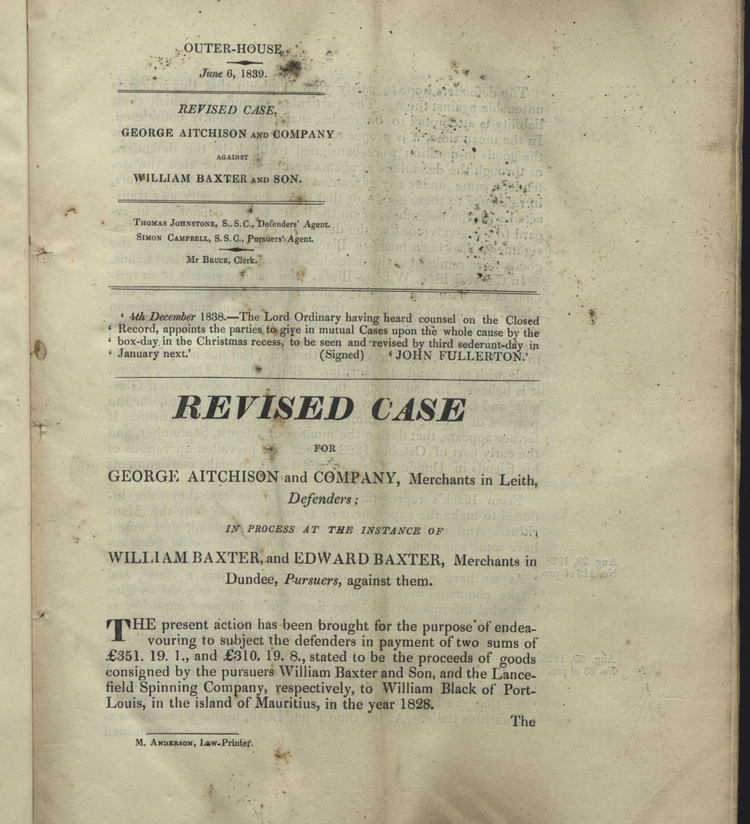
Data Selection
Manual inspection
www.cdcs.ed.ac.uk
Notes:
MT

Slide 39
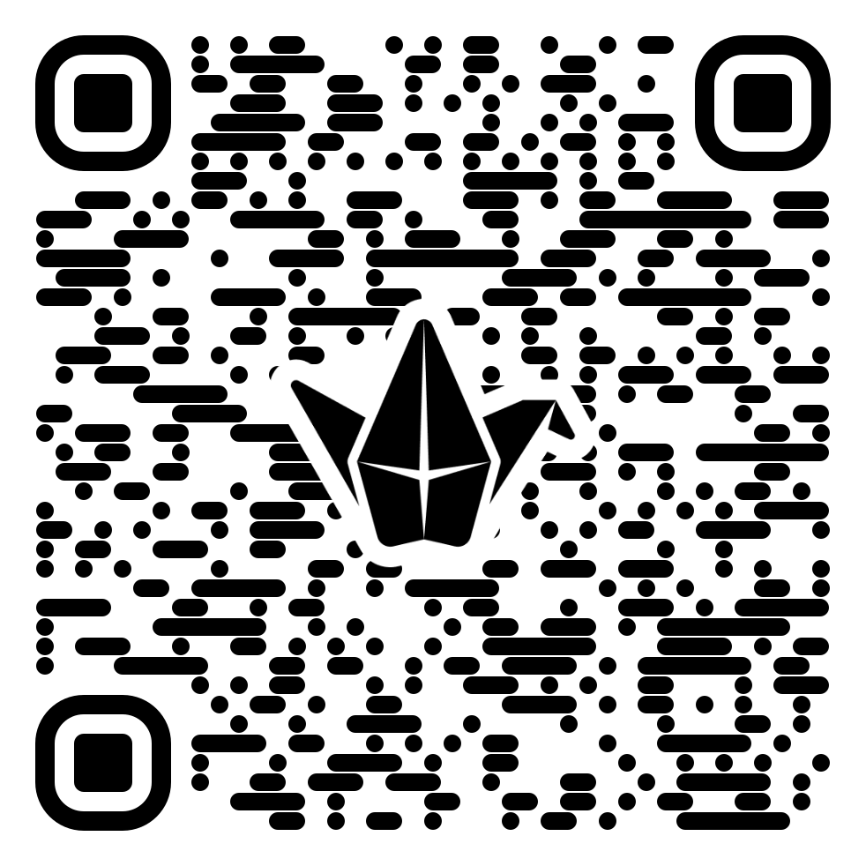
Activity:
Inspect the Images
Identify issues you might encounter when processing the following images.
Are there any steps you could take to preprocessing the document that might improve the output accuracy?
www.cdcs.ed.ac.uk

Slide 40
Manually: Adjust the colour, contrast, or formats of the files.
OCR tools: Some OCR software have built-in correction functions such as patches.
Pre-processing
www.cdcs.ed.ac.uk
Notes:
MT

Slide 41
Pay attention to the limitations of the software
File Size
File Format
Text orientation
Languages
Scanning
www.cdcs.ed.ac.uk
Notes:
MT

Slide 42
Activity: Scanning
Identify a picture or scanned pdf
Scan the documents with OCR software
Compare the results and discuss what are the advantages and limitations of these options?
(if you can't find one, please try the pictures in the previous slides, or you can also try the Edinburgh archive database:
https://archives.collections.ed.ac.uk/)
https://tools.pdf24.org/en/ocr-pdf
https://www.onlineocr.net/
https://www.sodapdf.com/ocr-pdf/
https://www.sejda.com/ocr-pdf
https://ocr.space/
https://avepdf.com/pdf-ocr
www.cdcs.ed.ac.uk

Slide 43
Manually remove errors
Predictable errors can be fixed with codes , such as Regex.
Cleaning
www.cdcs.ed.ac.uk
Notes:
MT

Slide 44
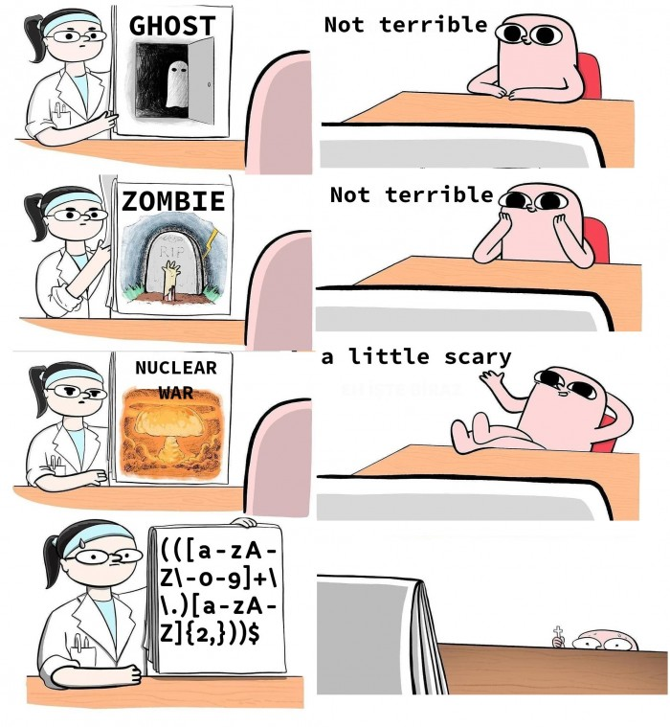
Regex
Concept used in many different programming environments for pattern matching.
Powerful tool to find, manage, and transform data and files.
Use a sequence of characters to define a search to match strings
Match on types of characters (e.g. ‘upper case letters’, ‘digits’, ‘spaces’, etc.).
Match patterns that repeat any number of times.
https://devhumor.com/media/the-nightmare
www.cdcs.ed.ac.uk
Notes:
MT

Slide 45
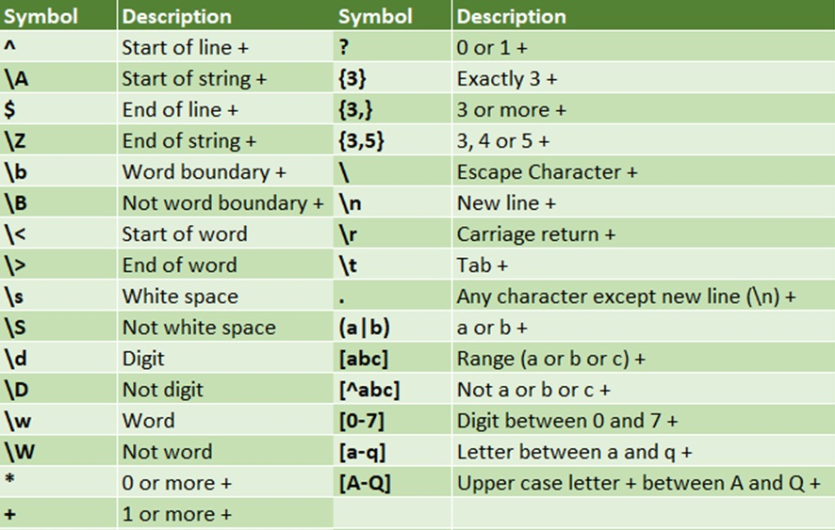
Regex
https://programminghistorian.org/en/lessons/cleaning-ocrd-text-with-regular-expressions
https://programminghistorian.org/en/lessons/understanding-regular-expressions
https://librarycarpentry.org/lc-data-intro/01-regular-expressions/
www.cdcs.ed.ac.uk
Notes:
MT

Slide 46
Printed Text Recognition
using Python pytesseract
Tesseract is an OCR engine developed for various operating systems
It has become open-source since 2005
It is of the most accurate open-source OCR engines available
Originally only support English, but more languages have been added
Can run from command line interface or embedded in main coding languages (R & Python)
www.cdcs.ed.ac.uk
Notes:
MT

Slide 47
Handwritten Text Recognition with Python trOCR
Select good quality dataset to begin with
Pre-process your dataset to improve its quality
Correct errors in OCR-produced files, if they are predictable.
Improve OCR engine capability
www.cdcs.ed.ac.uk
Notes:
MT

